Slide 1

Topic 1: Overview

Slide 2
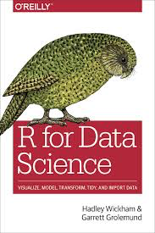
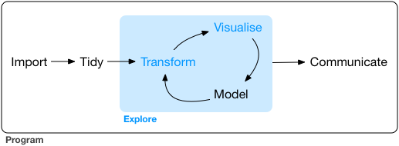
Objective
“The course will benefit operational research practitioners who support data-driven decision making within their organisation, and are interested in exploring new tools, workflows and methods to generate insights, and communicate these to key stakeholders”
https://r4ds.had.co.nz

Slide 3


Instructor –Jim Duggan
Lectures in
Programming (R, MATLAB),
Modelling & Simulation
Research interests:
System Dynamics
Computational Epidemiology
Data Science
https://education.rstudio.com/trainers/people/duggan+jim/
https://twitter.com/_jimduggan

Slide 4
Course Overview
Topic | Description
Day 1
1 | Introduction to R and R Studio Cloud
2 | Exploratory Data Analysis: the tibble and ggplot2
3 | Functions, Vectors and Lists
4 | Introduction to Functionals with purrr
4 | Data Transformation I with dplyr
Day 2
6 | Data Transformation II with dplyr
7 | Statistical Transformation with ggplot2
8 | Advanced Functionals and Modelling with purrr
9 | Exploratory Data Analysis - Case Study using aimsir17

Slide 5

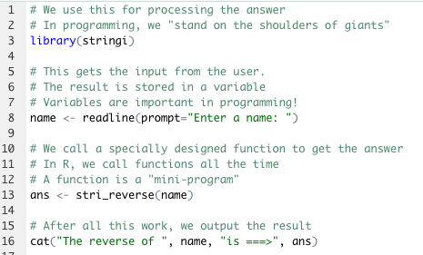
The R Project for Statistical Computing
R’s mission is to enable the best and most thorough exploration of data possible (Chambers 2008).
It is a dialect of the S language, developed at Bell Laboratories
ACM noted that S “will forever alter the way people analyze, visualize, and manipulate data”

Slide 6
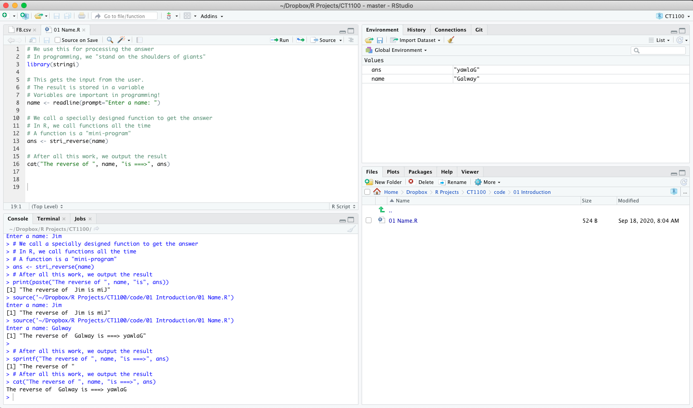
First Steps: RStudio Cloud!

Slide 7
(1) Create your account on https://rstudio.cloud and login

Slide 8
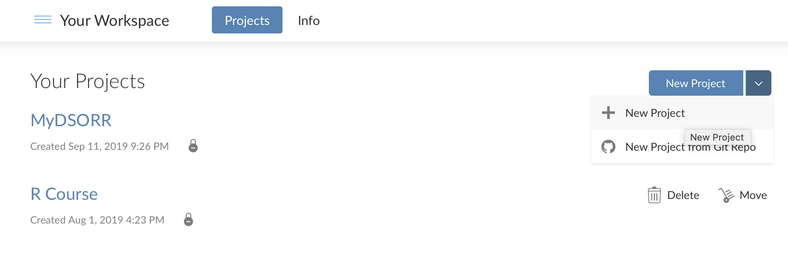
(2) In your workspace, create a project

Slide 9
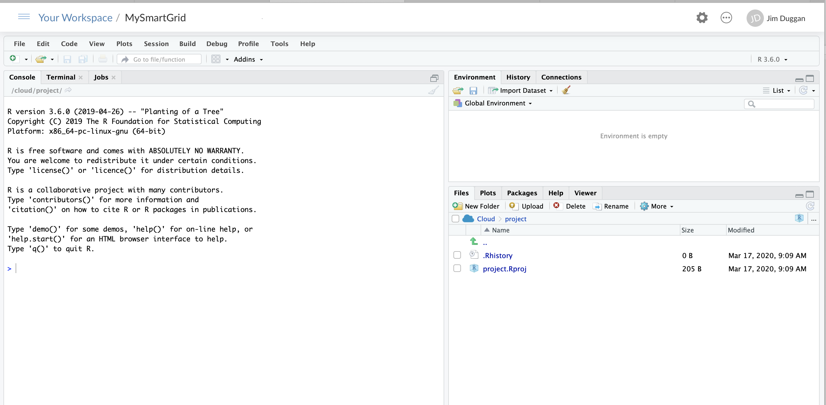
(3) Name the project (e.g. MySmartGrid)

Slide 10
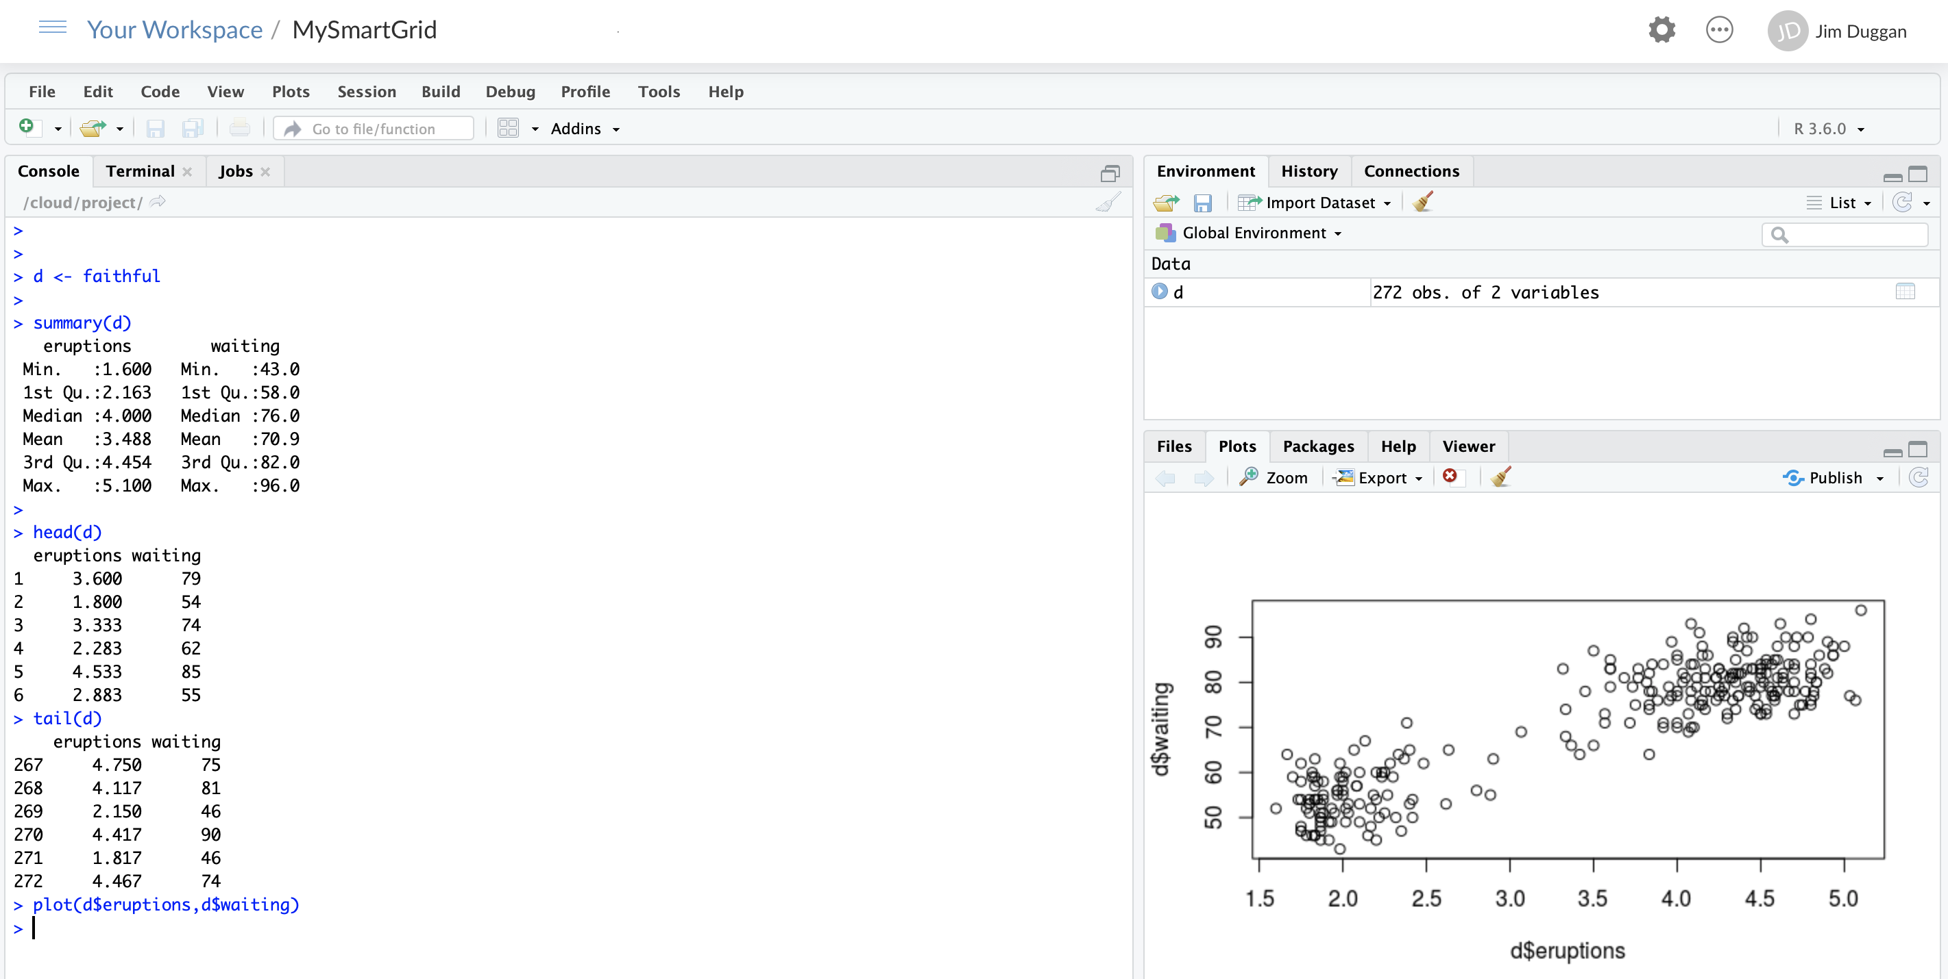
(4) Run some R code in Console

Slide 11
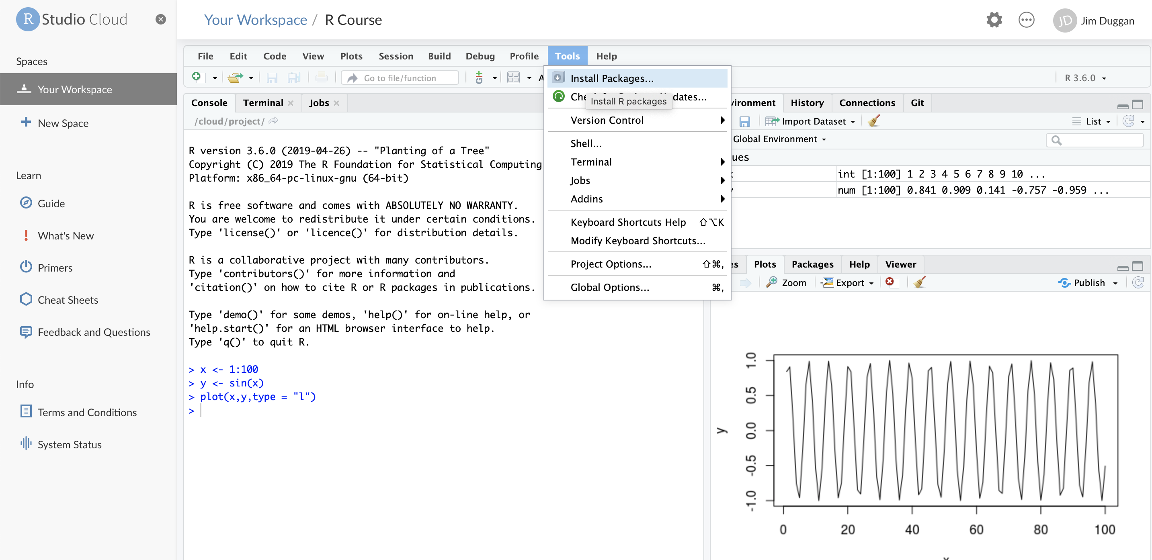
(5) Install required packages

Slide 12
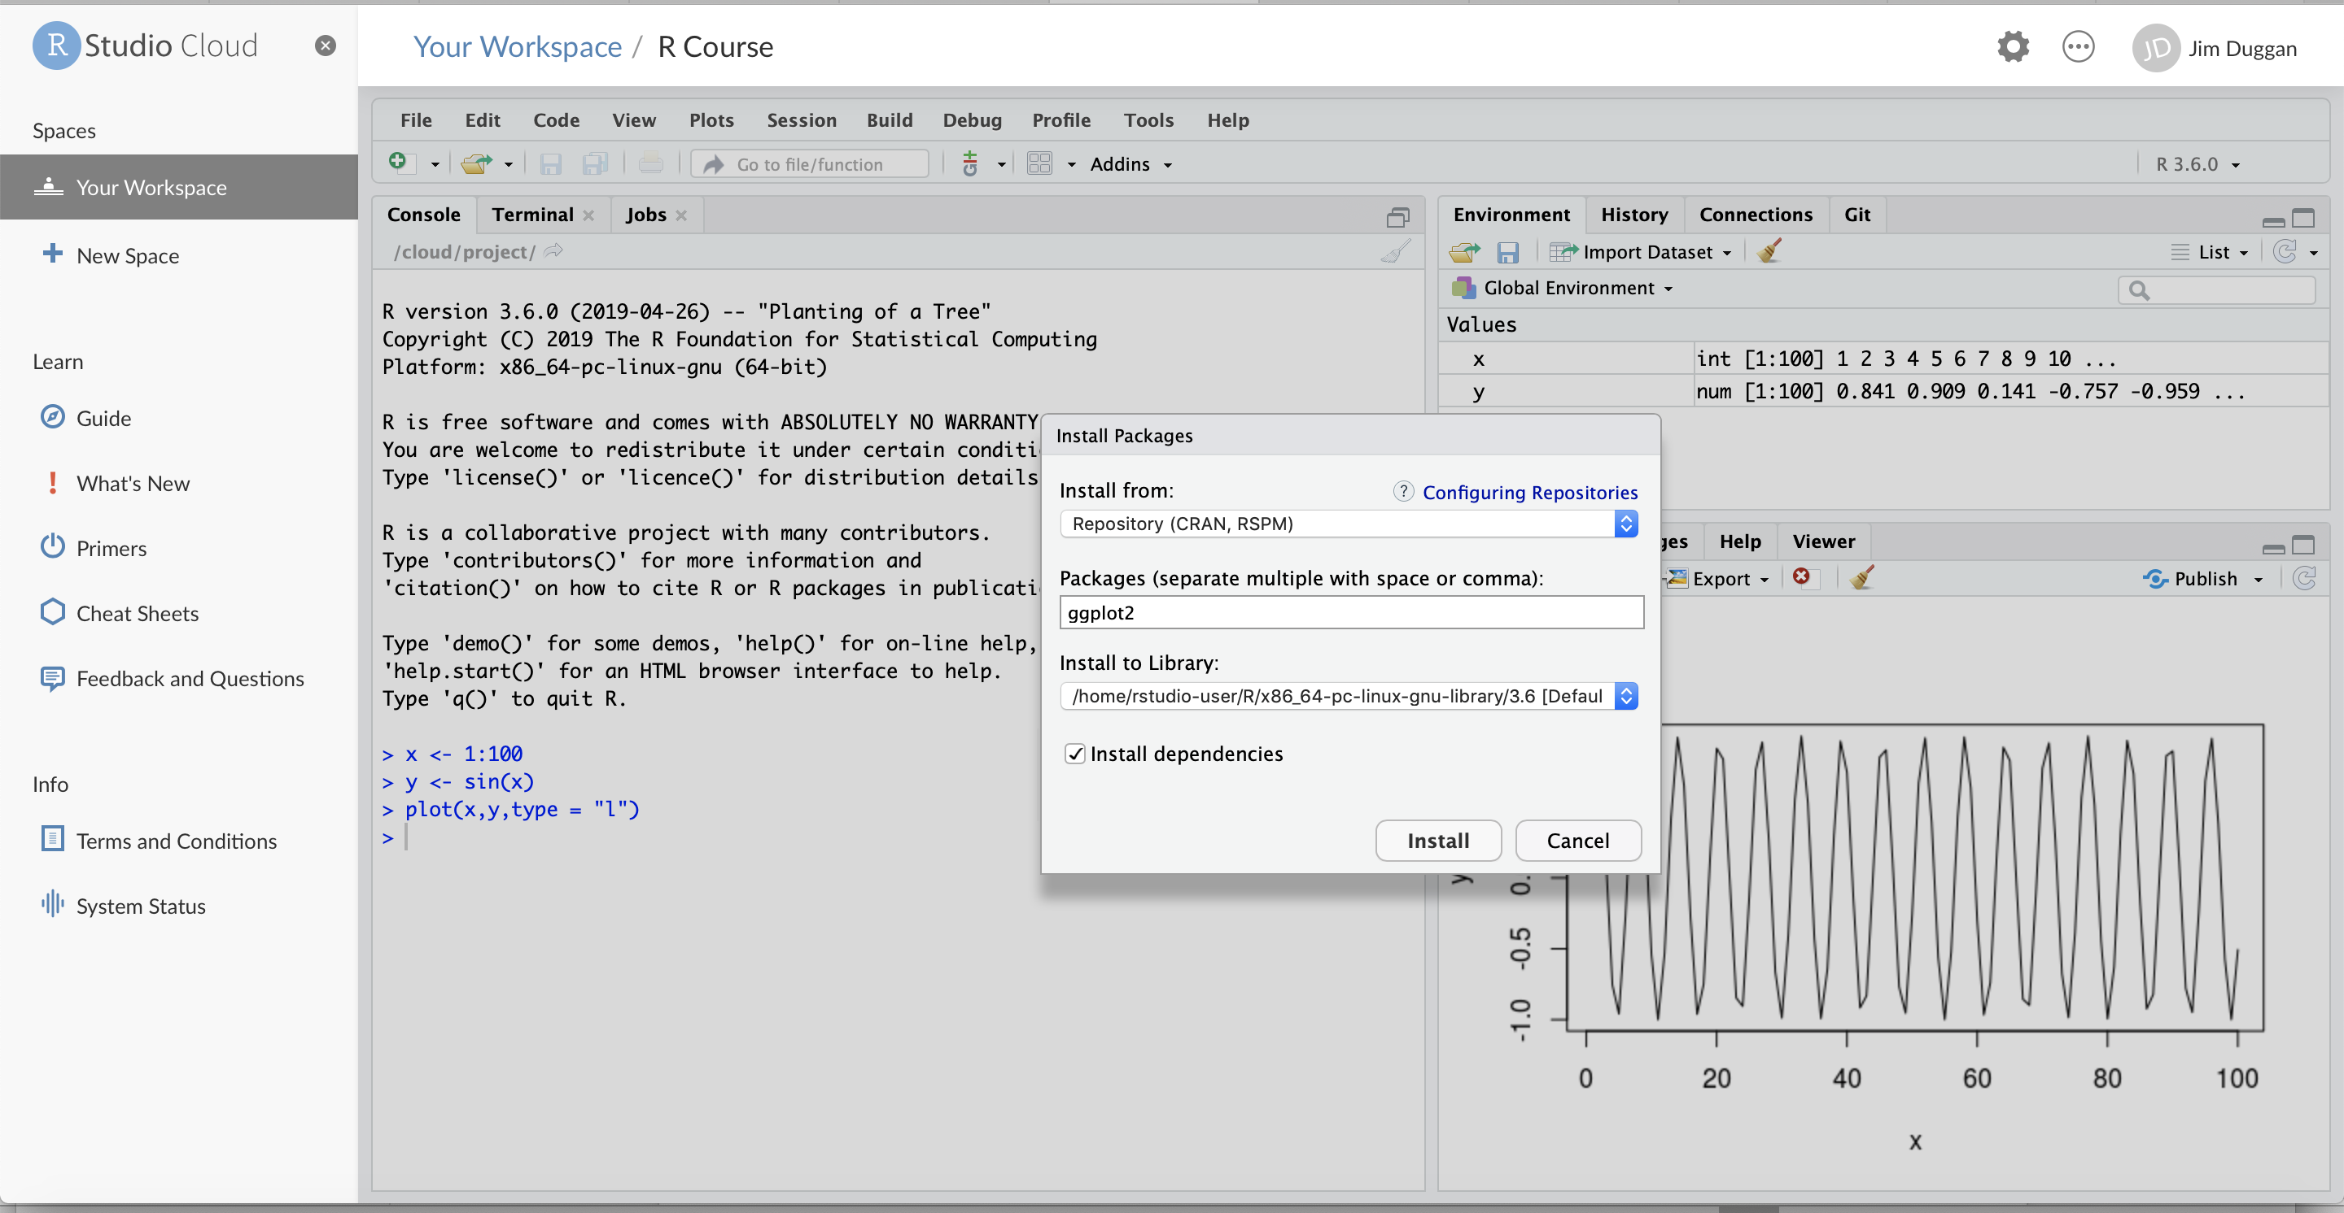
(6) For example, ggplot2

Slide 13
(7) Packages required
Package | Purpose
ggplot2 | Produce graphics for data
dplyr | Analysis of data held in tibbles/data frames
aimsir17 | 2017 Weather data for Ireland
purrr | To iterate over data structures
tidyr | To tidy rectangular data, and to nest data sets

Slide 14
Topic 2: Exploratory Data Analysis

Slide 15
Course Overview
Topic | Description
Session 1
1 | Introduction to R and R Studio Cloud
2 | Exploratory Data Analysis: the tibble and ggplot2
3 | Functions, Vectors and Lists
4 | Introduction to Functionals with purrr
4 | Data Transformation I with dplyr
Session 2
6 | Data Transformation II with dplyr
7 | Statistical Transformation with ggplot2
8 | Advanced Functionals and Modelling with purrr
9 | Exploratory Data Analysis - Case Study using aimsir17

Slide 16
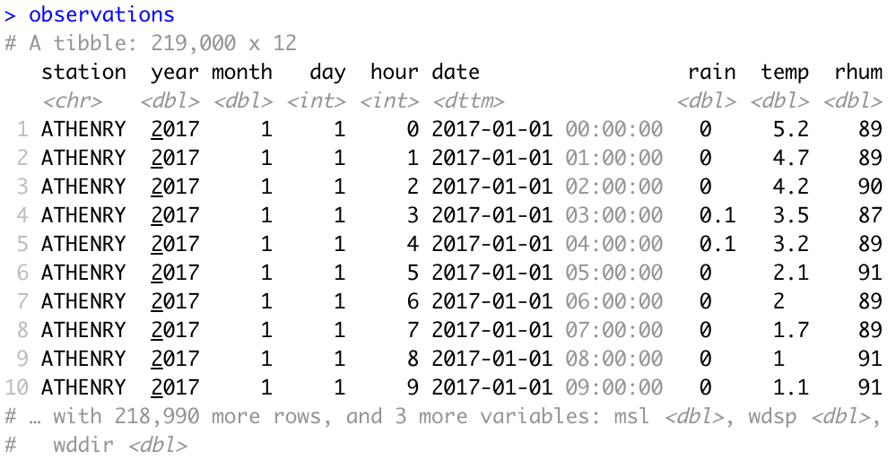
Data Frames/Tibbles
The most common way of storing data in R
A two-dimensional structure, with rows (observations) and columns (variables)

Slide 17
tibble abbreviations (variable types)
Abbreviation | Data Type
int | integers
dbl | doubles (real numbers)
chr | character vectors (strings
dttm | date-times
lgl | logical
fctr | factor (categorical variables with fixed possible values)
date | dates

Slide 18
Challenge 2.1
Explore some of the following tibbles in R
mpg (ggplot2)
flights (nycflights13)
observations (aimsir17)
eirgrid17 (aimsir17)
stations (aimsir17)

Slide 19
Exploratory Data Analysis: Goal
Develop an understanding of your data
Use questions as tools to guide your investigation
A creative process “the key to asking quality questions is to generate a large quantity of questions”
Useful to explore variation in variables

Slide 20
Data Exploration
“Data exploration is the art of looking at your data, rapidly generating hypotheses, quickly testing them, then repeating again and again and again.” (Wickham and Grolemund 2017).

Slide 21
Defining Important Terms (Wickham and Grolemund)
Term | Explanation
Variable | A quantity, quality or property that you can measure
Value | The state of a variable when you measure it. The value of a variable may change from measurement to measurement
Observation (or case) | A set of measurements made under similar conditions (you usually make all of the measurements in an observation at the same time and on the same object). An observation will contain several values, each associated with a different variable.
Tabular data | A set of values, each associated with a variable and an observation. Tabular data is tidy if each value is placed in its own “cell”, each variable in its own column, and each observation in its own row. All the data in aimsir17 and ggplot2 is tidy data.

Slide 22
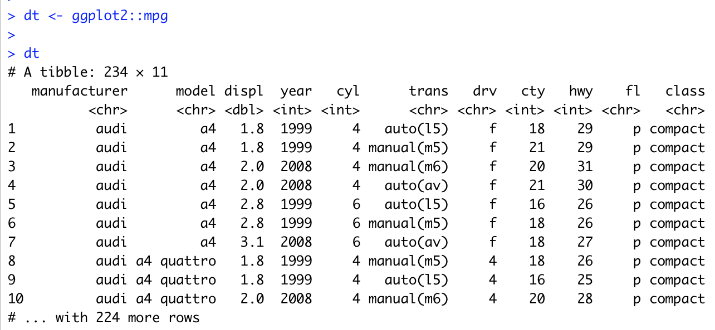
Data Visualisation with ggplot2
“The simple graph has brought more information to the data analyst’s mind that any other device.” – John Tukey

Slide 23
Fuel Economy Data Set (ggplot2::mpg)
This dataset contains a subset of the fuel economy data that the EPA makes available on http://fueleconomy.gov. It contains only models which had a new release every year between 1999 and 2008 - this was used as a proxy for the popularity of the car.
manufacturer | manufacturer | drv | f = front-wheel drive, r = rear wheel drive, 4 = 4wd
model | model name | cty | city miles per gallon
displ | engine displacement, in litres | hwy | highway miles per gallon
year | year of manufacture | fl | fuel type
cyl | number of cylinders | class | “type” of car
trans | type of transmission

Slide 24
First Steps
Generate a first graph to help answer the following question:
Do cars with big engines use more fuel than cars with small engines
What might the relationship between engine size and fuel efficiency look like?
Positive or negative?
Linear or non-linear?

Slide 25
Selecting data
Among the variables are:
displ, a car’s engine size in litres
hwy, a car’s fuel efficiency on the highway in miles per gallon

Slide 26
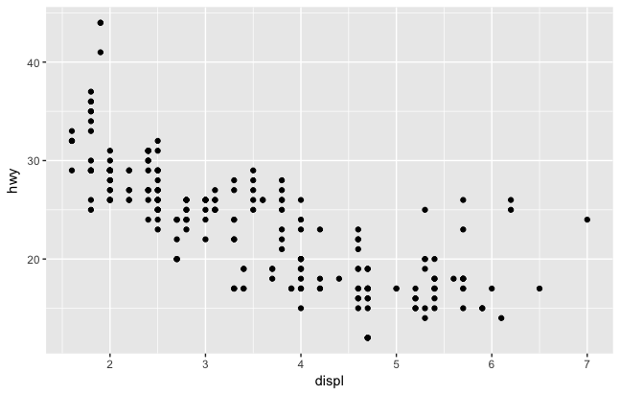
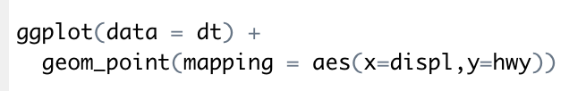
Creating a ggplot

Slide 27
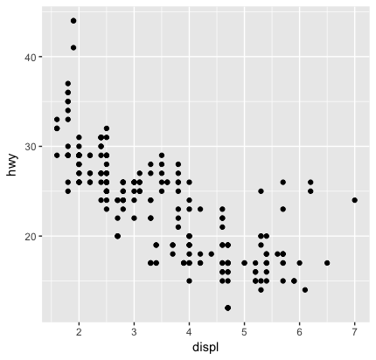
Interpreting the plot
The plot shows a negative relationship between engine size (displ) and fuel efficiency (hwy)
Cars with big engines use more fuel
Does this confirm or refute your hypothesis about fuel efficiency and engine size?

Slide 28
Challenge 2.2
What might the relationship between engine size and fuel efficiency (city mpg) look like?

Slide 29
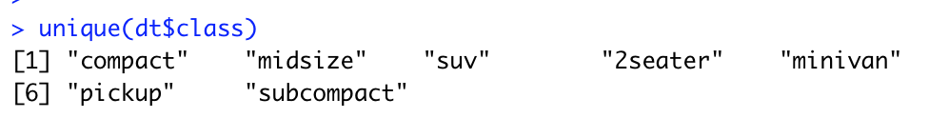
(2) Aesthetic Mappings
“The greatest value of a picture is when it forces us to notice what we never expected to see” – John Tukey
A third variable can be added to a 2-D plot by mapping it to an aesthetic.
An aesthetic is a visual property of the plot’s objects.
An aesthetic’s level could be colour, size or shape.

Slide 30
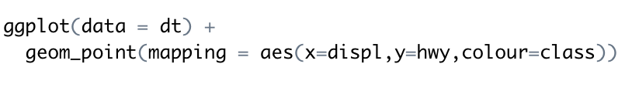
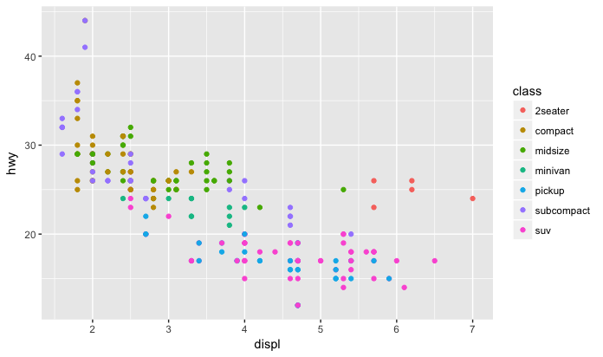

Slide 32
Challenge 2.3
Generate the following graph from aimsir17 (January)
Note: the tibble needs to be filtered

Slide 33
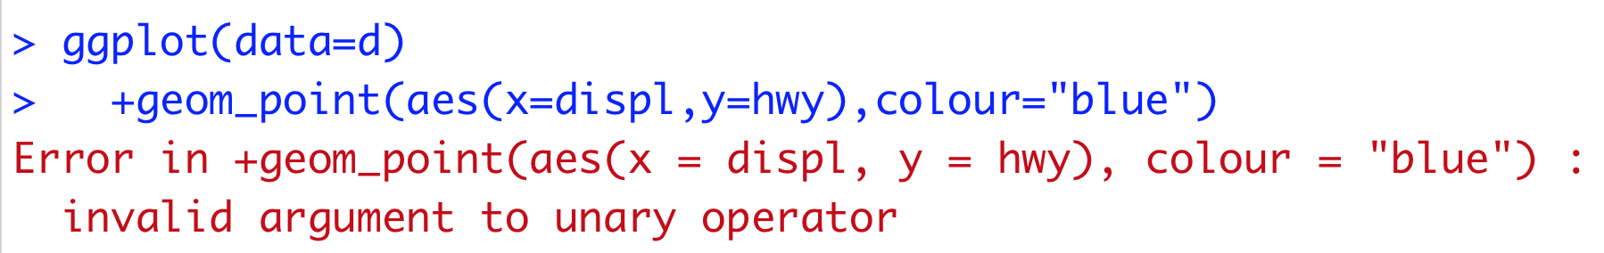
(3) Common Problems
R can be “extremely picky, and a misplaced character can make all the difference”
Make sure every ( is matched with a )
For ggplot calls, the + must come at the end of the line, not at the start (see below)
You can get help about any function by running ?function_name

Slide 34
(4) Facets
Another way to add categorical variables is to split a plot into facets, subplots that display one subset of the data.
To facet your plot by a single variable, use facet_wrap(), with ~ followed by the variable name
To facet on the combination of two variables, used facet_grid()

Slide 35
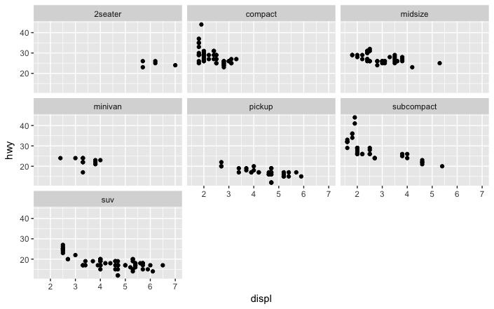

Slide 36
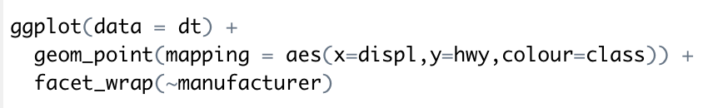
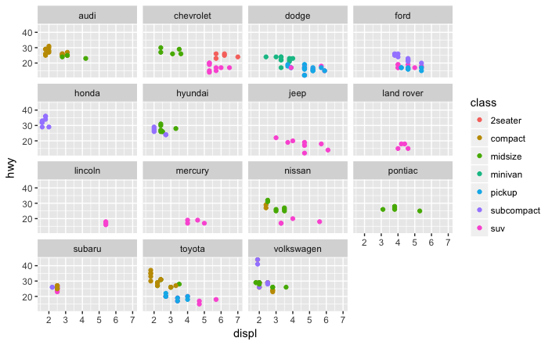

Slide 37
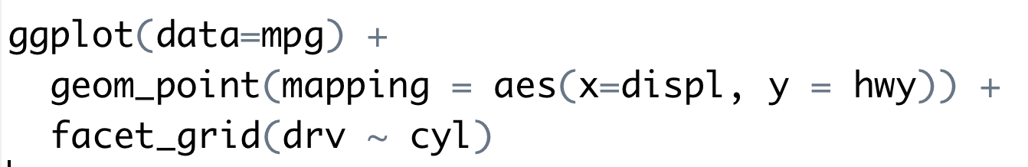
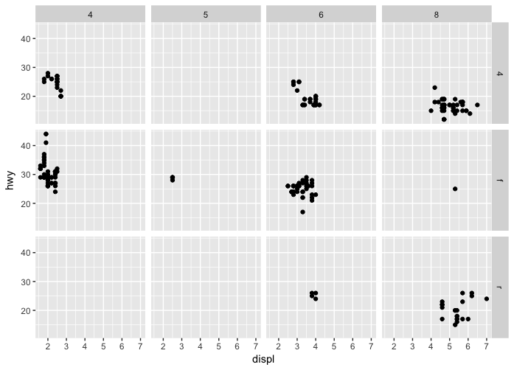

Slide 38
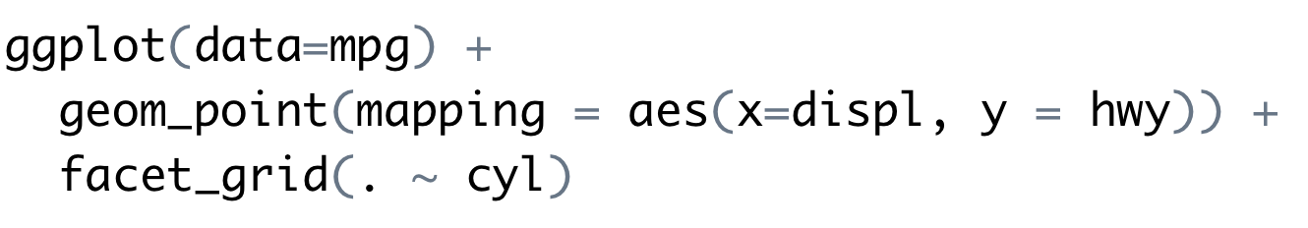
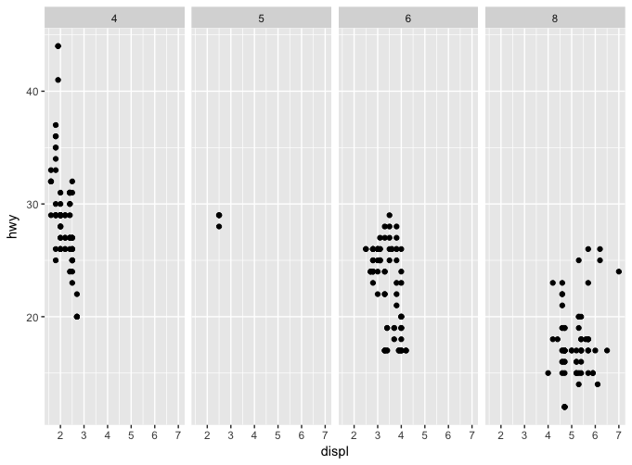

Slide 39
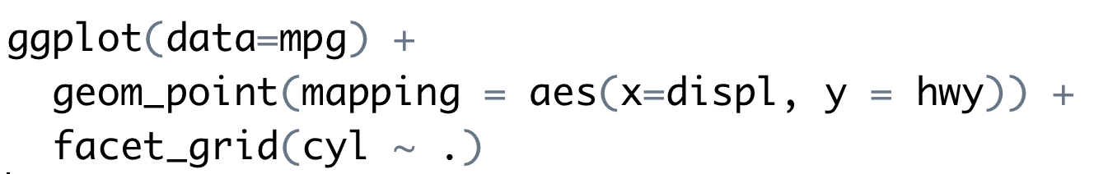
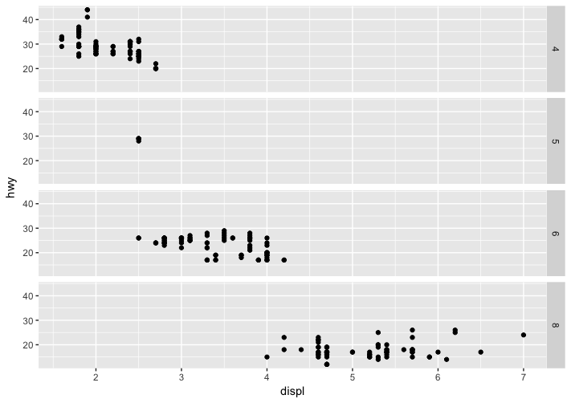

Slide 40
Challenge 2.4
Use facet_wrap to generate this for every weather station as a separate plot

Slide 41
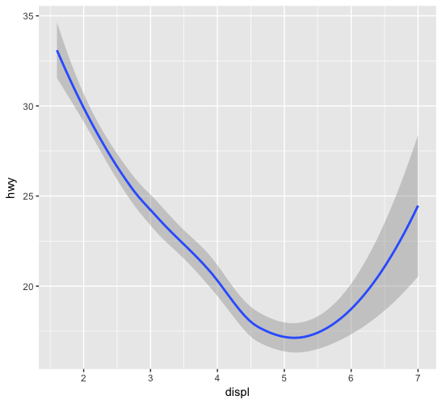
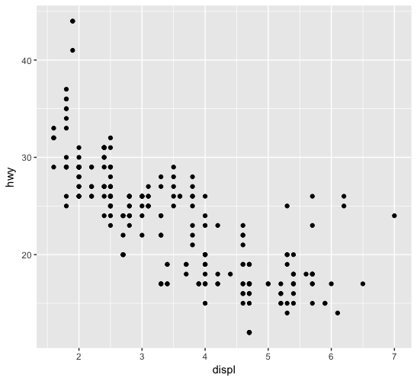
(5) Geometric Objects
Both of these plots contain the same x and y variable, and describe the same data
The plots are not identical, they use a different visual object to represent the data
In ggplot2 syntax, we say the use different geoms

Slide 42
geom
A geom is a geometrical object that a plot uses to represent data
Bar charts use bar geoms, line charts use line geoms, and scatter plots use the point geom.
To change the geom in your plot, simply change the geom function that is added to the ggplot call.

Slide 43
Sample plot geoms
Geom | Purpose
geom_smooth() | Fits a smoother to data and displays the smooth and its standard error
geom_boxplot() | Produces a box-and-whisker plot to summarise the distribution of a set of points
geom_histogram() geom_freqpoly() | Shows the distribution of continuous variables
geom_bar() | Shows the distribution of categorical variables
geom_path() geom_line() | Draws lines between data points
geom_area() | Draws an area plot, which is a line plot filled to the y-axis. Multiple groups will be stacked upon each other
geom_rect() geom_tile() geom_raster() | Draw rectangles
geom_polygon() | Draws polygons, which are filled paths.

Slide 44
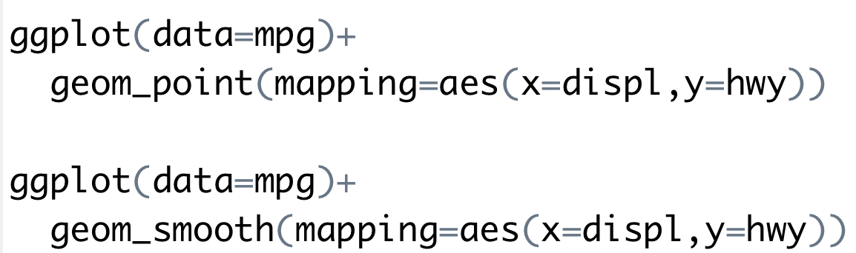
Examples of using different geoms

Slide 45
Challenge 2.5
Combine both these onto a single plot

Slide 46
Challenge 2.4
Generate the following graph from aimsir17. Focus on Athenry and Dublin Airport

Slide 47
Topic 3: Functions and Vectors

Slide 48
Course Overview
Topic | Description
Session 1
1 | Introduction to R and R Studio Cloud
2 | Exploratory Data Analysis: the tibble and ggplot2
3 | Functions, Vectors and Lists
4 | Introduction to Functionals with purrr
5 | Data Transformation I with dplyr
Session 2
6 | Data Transformation II with dplyr
7 | Statistical Transformation with ggplot2
8 | Advanced Functionals and Modelling with purrr
9 | Exploratory Data Analysis - Case Study using aimsir17

Slide 49
R – Data Types
 | Homogenous | Heterogenous
1d | Atomic Vector | List
2d | Matrix | Data Frame
nd | Array
The basic data structure in R is the Vector
Vectors come in two flavours
Atomic vectors
Lists
With atomic vectors, all elements have the same type

Slide 50
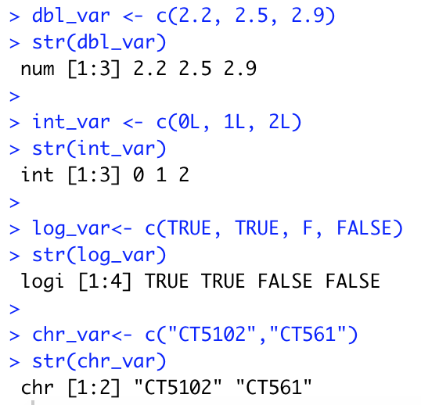
(1) Atomic Vectors
Four common types
logical
integer
double (or numeric)
character
Usually created with c() – short for combine

Slide 51
Creating atomic vectors using sequences
The colon operator (:) generates regular sequences (atomic vectors) within a specified range.
> v1<-1:10
> v1
[1] 1 2 3 4 5 6 7 8 9 10
> v2<-3:13
> v2
[1] 3 4 5 6 7 8 9 10 11 12 13

Slide 52
Coercion of atomic vectors
All elements of an atomic vector MUST be of the same type
When different type are combined, they will be coerced into the most flexible types
What will be the type and values of
c(1L, T, F)
c(1,T,F)

Slide 53
Coercion Rules Least to most flexible
logical
numeric
character
TRUE → 1
FALSE → 0
numeric
logical
character
Grolemund (2014) p 52

Slide 54
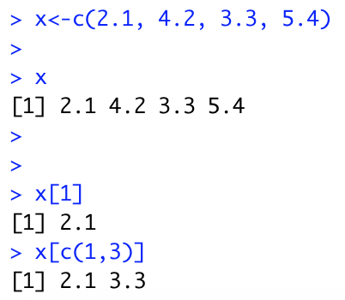
Subsetting Atomic Vectors
Subsetting data is a key activity in data science
R’s subsetting operators are powerful and fast
For atomic vectors, the operator [ is used
In R, the index for a vector starts at 1

Slide 55
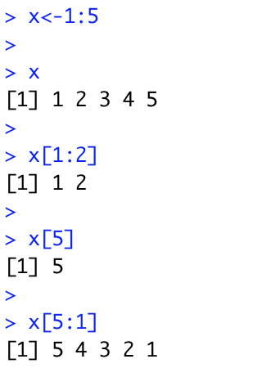
(a) Positive integers
1
2
3
4
5
Positive integers return elements at the specified position
1
2

Slide 56
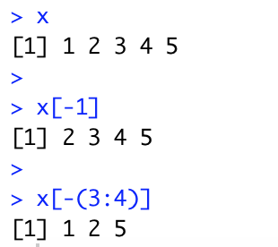
(b) Negative integers
1
2
3
4
5
Negative integers omit elements at specified positions
2
3
4
5

Slide 57
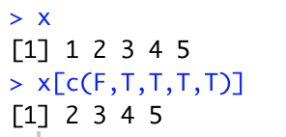
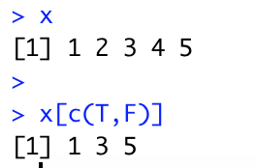
(c) Logical Vectors
1
2
3
4
5
Select elements where the corresponding logical value is TRUE. This approach supports recycling
F
T
T
T
T
2
3
4
5

Slide 58
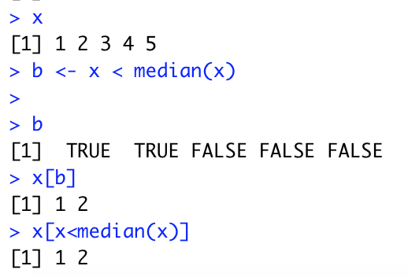
Logical Vectors - Advantages
Expressions can be used to create a logical vector

Slide 59
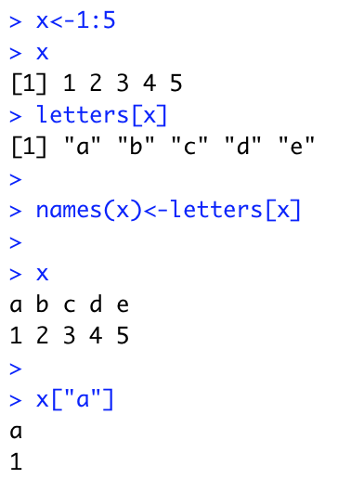
(4) Character vectors to subset
a b c d e
1
2
3
4
5
Return elements with matching names
a
1

Slide 60
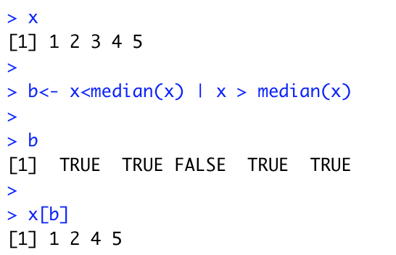
Logical Expressions in R
Operators | Description
< | less than
<= | less than or equal to
> | greater than
>= | greater than or equal to
== | exactly equal to
!= | not equal to
!x | not x
x | y | x OR y
x & y | x AND y

Slide 61
Challenge 3.1
Create an R vector of squares of 1 to 10
Find the minimum
Find the maximum
Find the average
Subset all those values greater than the average

Slide 62
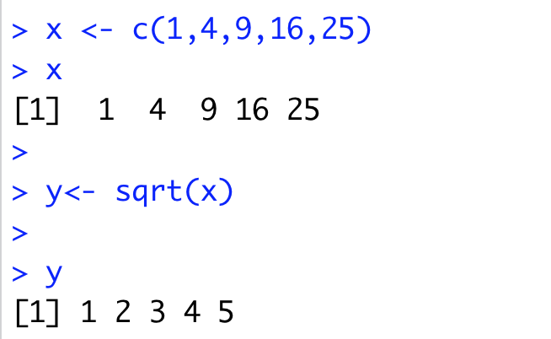
Vectorisation
A powerful feature of R is that it supports vectorisation
Functions can operate on every element of a vector, and return the results of each individual operation in a new vector.

Slide 63
Input Vector
Output Vector
1
1
4
2
sqrt()
9
3
16
4
25
5

Slide 64
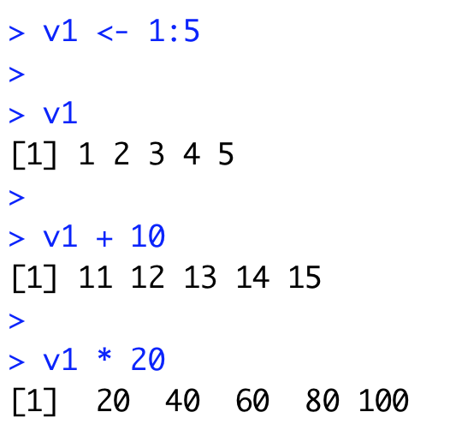
Arithmetic Operators
Arithmetic operations can also be applied to vectors in an element-wise manner

Slide 65
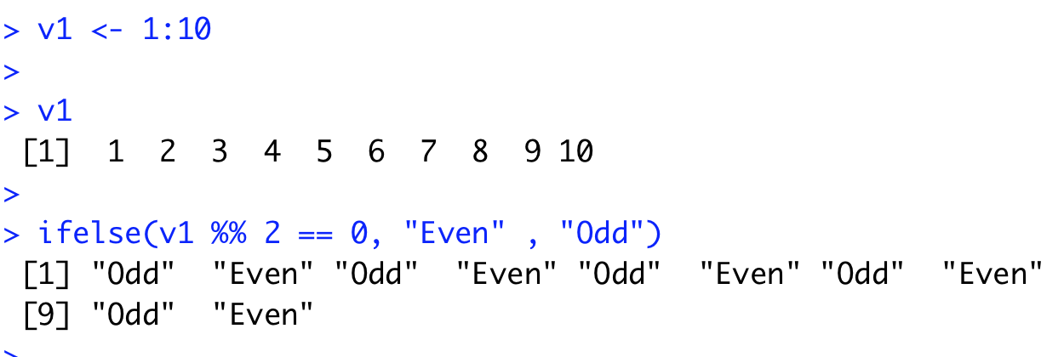
Vectorized if/else
Vectors can also be processed using the vectorized ifelse(b,u,v) function, which accepts a boolean vector b and allocates the element-wise results to be either u or v.

Slide 66
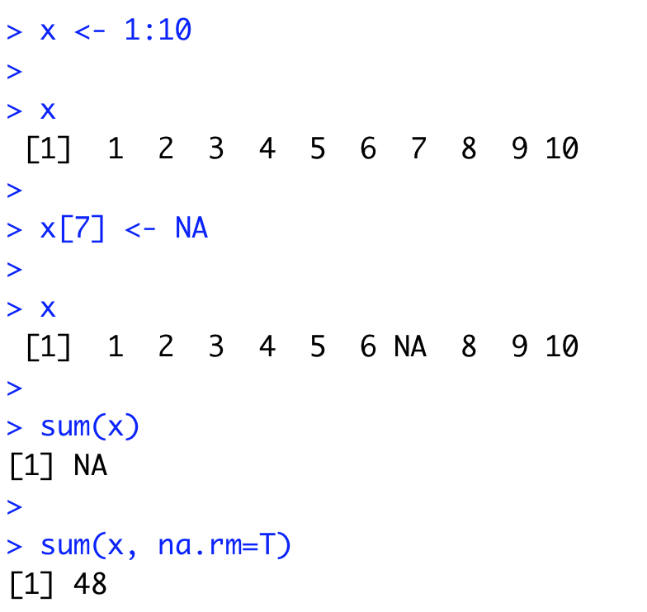
Missing Values - NA
In a project of any size, data is likely to be incomplete due to
Missed survey questions
Faulty equipment
Improperly coded data
In R, missing data is represented by the symbol NA

Slide 67
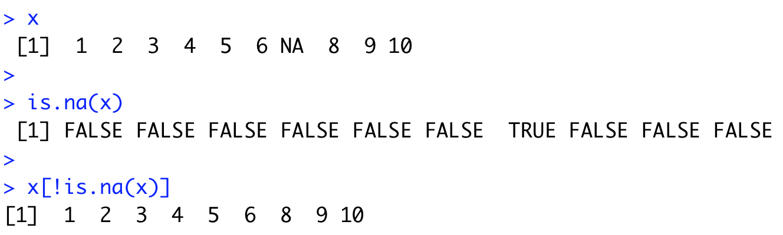
is.na() function
The function is.na() indicates which elements are missing
Returns a logical vector, the same size as the input vector

Slide 68
Challenge 3.2
Create a vector of 20 numbers
Set 5 of these to NA (random)
Print the locations of the missing values
Hint: Check out the R function which

Slide 69
(2) Lists
 | Homogenous | Heterogenous
1d | Atomic Vector | List
2d | Matrix | Data Frame
nd | Array
Lists are different from atomic vectors because their elements can be of any type, including lists.
list() creates a list, instead of c()

Slide 70
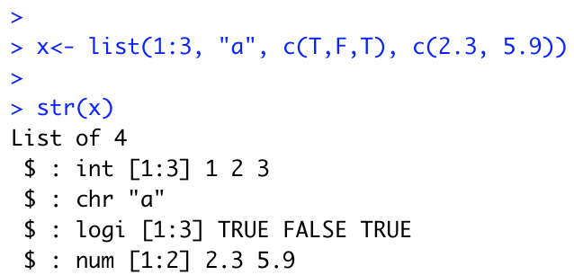
Creating a list…

Slide 71
Subsetting lists
Works in the same way as subsetting an atomic vector
Using [ will always return a list
[[ pulls out the contents of a list
If list x is a train carrying objects, then x[[5]] is the object in car 5, x[4:6] is a train of cars 4-6” @RLangTip
x[[5]]

Slide 72
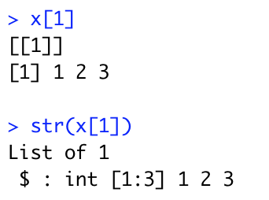
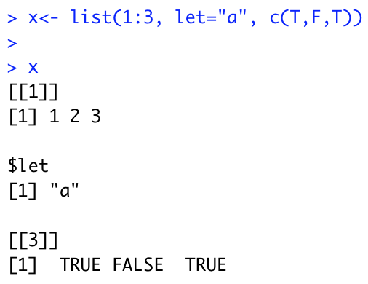
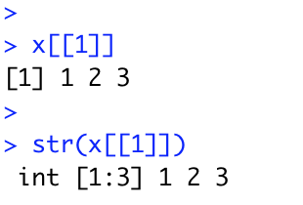
Example

Slide 73
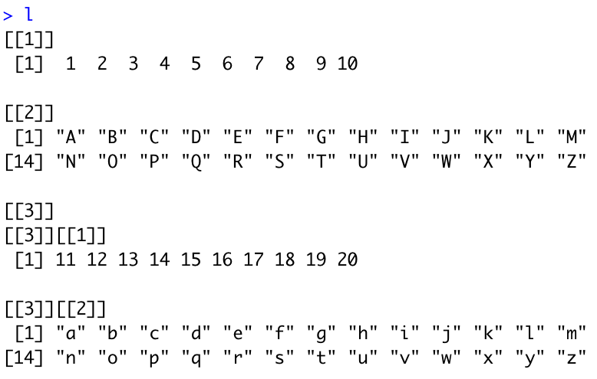
Challenge 3.3
Create a list that contains
A vector of integers (1:10)
A sequence of upper case letters (A-Z)
A list with:
A vector of integers (11:20)
A sequence of lower case letters (A-Z)

Slide 74
Extract the following
The first element as a vector
The second element as a vector
The third element as a list of a list
The third element as a list
The values 10, Q, 19 and the vector “w” ”x” “y”

Slide 75
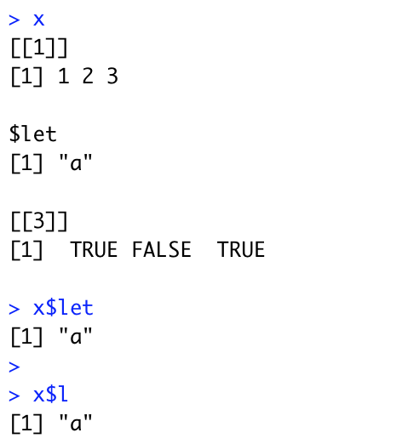
$ operator
$ is a shorthand operator, where x$y is equivalent to x[[“y”,exact=FALSE]]
When list elements are named, it can be used.
Often used to access variables in a data frame
$ does partial matching

Slide 76
Visualising Lists and Subsetting
Lists have rounded corners. Atomic vectors have square corners
Children are drawn inside their parent, and have a slightly darker background

Slide 77

x1
1
2
3
4

Slide 78
a
a[1:2]
1
2
3
1
2
3
“a string”
“a string”
3.141525
-1
-5

Slide 79
a
a[4]
1
2
3
“a string”
-1
-5
3.141525
-1
-5

Slide 80
a
a[[4]]
1
2
3
-1
-5
“a string”
a[[4]][1]
3.141525
-1
-1
-5
a[[4]][[1]]
a[[4]][[2]]
-1
-5

Slide 81
(3) Functions
A function is a group of instructions that:
takes input,
uses the input to compute other value, and
returns a result (Matloff 2009).
Functions are a fundamental building block of R (Wickham 2015)
Users of R should adopt the habit of creating simple functions which will make their work more effective and also more trustworthy (Chambers 2008).
Functions are declared:
using the function reserved word
are objects

Slide 82
General Form
function(arguments)
expression
arguments gives the arguments, separated by commas.
Expression (body of the function) is any legal R expression, usually enclosed in { }
Last evaluation is returned
return() can also be used, but usually for exceptions.
f()

Slide 83


Example
f()

Slide 84
Challenge 3.4
Write an R function that filters a vector to return all the even numbers
1 2 3 4 5
f()
2 4

Slide 85
Function Arguments
It is useful to distinguish between formal arguments and the actual arguments
Formal arguments are the property of the function
Actual arguments can vary each time the function is called.
When calling functions, arguments can be specified by
Complete name
Partial name
Position

Slide 86




Slide 87
Guidelines (Wickham 2015)
Use positional mapping for the first one or two arguments (most commonly used)
Avoid using positional mapping for less commonly used attributes
Named arguments should always come after unnamed arguments

Slide 88

Passing functions as objects
Functions are first class objects, so they can be passed to other functions
Provides flexibility, and widely used in R

Slide 89

Challenge 3.5
Write a function that takes in a vector and returns a vector with no duplicates. Make use of the R function duplicated()

Slide 90

(3) Environments in R
Environments can be thought of as consisting of two things: a frame, which is a set of symbol-value pairs, and an enclosure, a pointer to an enclosing environment
Every object (variable or function) in an environment has a unique name
The working environment is known as the Global Environment
b
c
a

Slide 91

Hierarchy of Environments
globalenv()
baseenv()
emptyenv()
Environments form a tree structure in which the enclosures play the role of parents. The tree of environments is rooted in an empty environment, available through emptyenv(), which has no parent

Slide 92

Examining the hierarchy with search()

Slide 93

Functions and their Environment
Functions are first class objects that exist in an environment
Functions can access all variables contained in their enclosing environment
When functions are executed, they have their own environment (to be covered later in the advanced topic)

Slide 94


Looking for variables…
If a name isn’t defined inside a function, R will look one level up to the enclosing environment.

Slide 95
Challenge 3.6
Write a function in R that will return the square of a number in its environment.

Slide 96
Topic 4: Functionals and purrr

Slide 97
Course Overview
Topic | Description
Session 1
1 | Introduction to R and R Studio Cloud
2 | Exploratory Data Analysis: the tibble and ggplot2
3 | Functions, Vectors and Lists
4 | Introduction to Functionals with purrr
5 | Data Transformation I with dplyr
Session 2
6 | Data Transformation II with dplyr
7 | Statistical Transformation with ggplot2
8 | Advanced Functionals and Modelling with purrr
9 | Exploratory Data Analysis - Case Study using aimsir17

Slide 98
Functionals
Data
A functional is a function that takes data and a function as inputs, and returns a vector as output
The output is usually the same size as the input.
Commonly used as an alternative for loops
The purrr package contains an excellent resource for functionals
Function
A Functional
Transformed
Data

Slide 99

Introduction to purrr
http://www.rebeccabarter.com/blog/2019-08-19_purrr/
purrr is all about iteration.
purrr introduces map functions (the tidyverse’s answer to base R’s apply functions, but more in line with functional programming practices) as well as some new functions for manipulating lists

Slide 100
Introduction to purrr
http://www.rebeccabarter.com/blog/2019-08-19_purrr/
While the workhorse of dplyr is the data frame, the workhorse of purrr is the list.
A vector is a way of storing many individual elements (a single number or a single character or string) of the same type together in a single object,
A data frame is a way of storing many vectors of the same length but possibly of different types together in a single object
A list is a way of storing many objects of any type (e.g. data frames, plots, vectors) together in a single object

Slide 101

(1) Map functions
A map function is one that applies the same action/function to every element of an object (e.g. each entry of a list or a vector, or each of the columns of a data frame)
The naming convention of the map functions are such that the type of the output is specified by the term that follows the underscore in the function name
Consistent with the way of the tidyverse, the first argument of each mapping function is always the data object that you want to map over, and the second argument is always the function that you want to iteratively apply to each element of the input object

Slide 102


The input object
The input object to any map function is always either
a vector (of any type), in which case the iteration is done over the entries of the vector,
a list, in which case the iteration is performed over the elements of the list,
a data frame, in which case the iteration is performed over the columns of the data frame (which, since a data frame is a special kind of list, is technically the same as the previous point).

Slide 103


Iteration example

Slide 104
The output
The first element of the output is the result of applying the function to the first element of the input (1),
The second element of the output is the result of applying the function to the second element of the input (4),
The third element of the output is the result of applying the function to the third element of the input (7).

Slide 105


map() always returns a list

Slide 106

Challenge 4.1
For the data frame mtcars, get the mean values for each column, using map()

Slide 107


(2) Adding Anonymous Functions

Slide 108

Modifying the output from map
If we wanted the output of map to be some other object type, we need to use a different function.
For instance to map the input to a numeric (double) vector, you can use the map_dbl() (“map to a double”) function

Slide 109

(3) The tilde-dot shorthand for functions
To make the code more concise you can use the tilde-dot shorthand for anonymous functions (the functions that you create as arguments of other functions).
~ indicates that you have started an anonymous function, and the argument of the anonymous function can be referred to using .x (or simply .).
Unlike normal function arguments that can be anything that you like, the tilde-dot function argument is always .x.

Slide 110
Challenge 4.2
Write a map function that takes in a list of elements, and then returns (as an integer) the number of elements in each list
Use the ~ operator to perform the same task

Slide 111
Challenge 4.3
Use the interval [-10,10] for x, and the seq() function to generate the values in steps of 0.1
Generate the response f(x) by calling map_db()
Plot the response using qplot() – part of ggplot2
f(x) = ax² + bx + c

Slide 112



Slide 113
Topic 5: Data Transformation with dplyr – Part 1

Slide 114
Course Overview
Topic | Description
Session 1
1 | Introduction to R and R Studio Cloud
2 | Exploratory Data Analysis: the tibble and ggplot2
3 | Functions, Vectors and Lists
4 | Introduction to Functionals with purrr
5 | Data Transformation I with dplyr
Session 2
6 | Data Transformation II with dplyr
7 | Statistical Transformation with ggplot2
8 | Advanced Functionals and Modelling with purrr
9 | Exploratory Data Analysis - Case Study using aimsir17

Slide 115
Overview
Visualisation is an important tool for insight generation, but it’s rare that you get the data in exactly the right form you need (Wickham and Grolemund 2017)
Create new variables
Create summaries
Order data
dplyr package is designed for data transformation

Slide 116
Recap - Data Frames/Tibbles
The most common way of storing data in R
A two-dimensional structure, with rows (observations) and columns (variables)

Slide 117

aimsir17

Slide 118
dplyr Basics: 5 key functions
Function | Purpose
filter() | Pick observations by their values
arrange() | Reorder the rows
select() | Pick variables by their names
mutate() | Create new variables with functions of existing variables
summarise() | Collapse many values down to a single summary
”A grammar of data manipulation”
All verbs (functions) work similarly
The first argument is a data frame/tibble
The subsequent arguments decide what to do with the data frame/tibble
The result (data frame/tibble) supports chaining of steps – NOTE the “pipe operator” which we will cover later.
https://dplyr.tidyverse.org

Slide 119

1. filter()
First argument the name of the data frame
Subsequent arguments are expressions that filter the data frame
Subsequent arguments can be viewed as a succession of “and” statements
Number of columns does not change
Number of rows reduced (filtered)

Slide 120
Relational operators in R
Operators | Description
< | less than
<= | less than or equal to
> | greater than
>= | greater than or equal to
== | exactly equal to
!= | not equal to
!x | not x
x | y | x OR y
x & y | x AND y

Slide 121

Show rows for “MACE HEAD” in January

Slide 122

Useful approaches for filtering more than one value
%in% operator in R

Slide 123
Challenge 5.1
Show the weather for “ROCHES POINT” on October 16th at 12 midday

Slide 124

2. arrange()
Changes the order of rows.
Used for sorting values
Takes a tibble and a set of column names to order by

Slide 125

Mean Sea Level Pressure

Slide 126

Humidity

Slide 127

More than one value

Slide 128

In descending order - desc()

Slide 129

Mean Sea Level Pressure

Slide 130

Windspeed

Slide 131
Challenge 5.2
Arrange the observations by month and by highest temperature

Slide 132

3. select()
It is not uncommon to get datasets with hundreds, or even thousands, of variables
A challenge is to narrow down on the variables of you’re interested in
select() allows you to rapidly zoom in on a useful subset using operations based on the variable names
Number of rows does not change

Slide 133


Useful options with select()

Slide 134

Special functions with select()

Slide 135


Examples

Slide 136

everything()

Slide 137
Summary: 3 of the 5 verbs
Function | Purpose
filter() | Pick observations by their values
arrange() | Reorder the rows
select() | Pick variables by their names
mutate() | Create new variables with functions of existing variables
summarise() | Collapse many values down to a single summary
”A grammar of data manipulation”
All verbs (functions) work similarly
The first argument is a data frame/tibble
The subsequent arguments decide what to do with the data frame/tibble
The result (data frame/tibble) supports chaining of steps – NOTE the “pipe operator” which we will cover later.
https://dplyr.tidyverse.org

Slide 138
Challenge 5.3
Create tibble one that has the columns month, hour, day, date, station and msl
Filter the tibble to a second tibble for October 16th, and for “VALENTIA OBSERVATORY” and “DUBLIN AIRPORT”
Display the hourly values on a time series (x axis is date) using ggplot2 with the aesthetic set to station

Slide 139


Combining operations with the Pipe
The pipe %>% comes from the magrittr package (Stefan Milton Bache)
Helps to write code that is easier to read and understand
x %>% f(y) turns into f(x, y)
x %>% f(y) %>% g(z) turns into g(f(x, y),z)
https://magrittr.tidyverse.org

Slide 140


Examples

Slide 141
dplyr Basics: 5 key functions
Function | Purpose
filter() | Pick observations by their values
arrange() | Reorder the rows
select() | Pick variables by their names
mutate() | Create new variables with functions of existing variables
summarise() | Collapse many values down to a single summary
”A grammar of data manipulation”
All verbs (functions) work similarly
The first argument is a data frame/tibble
The subsequent arguments decide what to do with the data frame/tibble
The result (data frame/tibble) supports chaining of steps – NOTE the “pipe operator” which we will cover later.
https://dplyr.tidyverse.org

Slide 142
4. mutate()
It is often useful to add new columns that are functions of existing columns
mutate() always adds new columns at the end of your data set.
For example, convert the mph wind speed in observations to a new column, kph.
Use a simplified observations tibble with day, month, station, wdsp as columns, and for “ROCHES POINT” on October 16th
Assume 1 mi = 1.609344 km

Slide 143


Example of mutate

Slide 144
Useful Creation Functions
There are many functions for creating new variables that can be used with mutate()
The key property is that the function must be vectorised:
It must take a vector of values as input, and,
Return a vector with the same number of values as output

Slide 145
Challenge 8.1
Add a new column rain_in, which measures the hourly rainfall in inches
Assume a conversion constant of 1 mm = 0.0393701 inches

Slide 146
dplyr Basics: 5 key functions
Function | Purpose
filter() | Pick observations by their values
arrange() | Reorder the rows
select() | Pick variables by their names
mutate() | Create new variables with functions of existing variables
summarise() | Collapse many values down to a single summary
All verbs (functions) work similarly
The first argument is a data frame
The subsequent arguments decide what to do with the data frame
The result is a data frame (supports chaining of steps)

Slide 147

5. summarise()
The last key verb is summarise()
It collapses a data frame into a single row
Not very useful unless paired with group_by()
Very useful to combine with the pipe operator

Slide 148

group_by()
Most data operations are useful done on groups defined by variables in the the dataset.
The group_by function takes an existing tbl and converts it into a grouped tbl where operations are performed "by group”.

Slide 149

Key idea
This grouping can then be exploited by summarise

Slide 150
Overall idea…
Original data frame
Grouped data frame
group_by()
summarise()

Slide 151
Useful Summary Functions
Grouping | Examples
Measures of location | mean(), median()
Measures of spread | sd(), IQR(),mad()
Measures of rank | min((), quantile(), max()
Measures of position | first(), nth(), last()
Counts | n(), n_distinct()
Counts and proportions of logical values | sum(x>0) when used with numeric functions, (T,F) converted to (1,0)

Slide 152
Challenge 8.2
For “BELMULLET” calculate the total daily rainfall for October, and show using ggplot.

Slide 153
dplyr Summary: 5 key functions
Function | Purpose
filter() | Pick observations by their values
arrange() | Reorder the rows
select() | Pick variables by their names
mutate() | Create new variables with functions of existing variables
summarise() | Collapse many values down to a single summary
”A grammar of data manipulation”
All verbs (functions) work similarly
The first argument is a data frame/tibble
The subsequent arguments decide what to do with the data frame/tibble
The result (data frame/tibble) supports chaining of steps – NOTE the “pipe operator” which we will cover later.
https://dplyr.tidyverse.org

Slide 154

dplyr 0.7.0, some new additions
Two new data sets: starwars and storms
pull() verb
case_when(), valuable for mutate operations instead of nested ifs

Slide 155


pull() – Select 1 column as a vector

Slide 156

pull() – Also works with column numbers, default is last column

Slide 157
case_when()
This function allows you to vectorise multiple if and else if statements. It is an R equivalent of the SQL CASE WHEN statement. Arguments:
A sequence of two-sided formulas. The left hand side (LHS) determines which values match this case. The right hand side (RHS) provides the replacement value.
The LHS must evaluate to a logical vector. Each logical vector can either have length 1 or a common length. All RHSs must evaluate to the same type of vector.
Proceed from the most specific to the most general

Slide 158


Very useful in mutate()

